Slide 1
Overview of Network Simulator – 3 (ns-3)
Mr. Shivaji R. Lahane
shivajilahane@gmail.com

Slide 2
Agenda
Differentiating ns-2 and ns-3
Introduction to ns-3
Features of ns-3
Modules available in ns-3
Key Abstractions
What is a node in ns-3?
Example – Conceptual
Post processing utilities for ns-3

Slide 3
Differentiating ns-2 and ns-3
The Choice of Programming Language:
OTcl in ns-2, C++ in ns-3
Not possible to run a simulation in ns-2 purely from C++.
Some components in ns-2 are written in OTcl and some in C++.
Simulations in ns-3 can be run using purely C++ or in Python.
Components in ns-3 are completely written in C++.
3
Ref.: http://www.nsnam.org/

Slide 4
Differentiating ns-2 and ns-3
Simulation Output:
NAM and Trace files in ns-2, NetAnim and PCAP Trace files in ns-3
Network Animator (NAM) is used as a visualization tool in ns-2.
NetAnim is used as a visualization tool in ns-3.
ns-2 generates “nam” and “trace” files for animation purpose.
ns-3 uses “.pcap” and “.tr” trace files for animation purpose.
4
Ref.: http://www.nsnam.org/

Slide 5
Differentiating ns-2 and ns-3
Performance:
Slow with ns-2, Efficient with ns-3
ns-2 lacks proper memory management strategies.
Interfacing OTcl with C++ incurs overhead in ns-2.
Yet another overhead is of OTcl interpreter.
5
Ref.: http://www.nsnam.org/

Slide 6
Differentiating ns-2 and ns-3
Approach for building:
Complex with ns-2, Simple with ns-3
makefile for ns-2, waf for ns-3
No “ns” executable in ns-3.
Recompiling of ns-2 involves several steps.
Recompiling of ns-3 easier with waf
6
Ref.: http://www.nsnam.org/

Slide 7
Differentiating ns-2 and ns-3
Application and Transport Layer Support
Abundant in ns-2, Sufficient in ns-3
ns-2: Ping, telnet, FTP, multicast, probabilistic and trace-driven traffic generation, webcache, etc.
ns-3: Sockets-like API, Peer-to-Peer Networks, traffic generator, etc
ns-2: TCP, UDP, SCTP and Multicast protocols.
ns-3: TCP stack emulation (Linux, BSD), TCP Variants, UDP, etc.
7
Ref.: http://www.nsnam.org/

Slide 8
Differentiating ns-2 and ns-3
Network Layer Support
Sufficient in ns-2, Improving in ns-3
ns-2: Unicast - IP, MIP, DV, LS, Multicast: SR
MANET - AODV, DSR, DSDV, TORA. Queuing - DiffServ, RED, WFQ, DropTail
ns-3: full IPv4 & IPv6 support, NAT, BGP, OSPF, RIP, IGMP, etc
MANET - AODV, DSR, DSDV, OLSR
8
Ref.: http://www.nsnam.org/

Slide 9
Differentiating ns-2 and ns-3
Community Support:
Very good for ns-2, Improving for ns-3
ns-2 has a more diverse set of contributed modules than does ns-3.
A lot of documentation exists for ns-2
ns-3 has more detailed models for upcoming networks like Long Term Evolution (LTE), Wi-Fi, etc.
9
Ref.: http://www.nsnam.org/

Slide 10
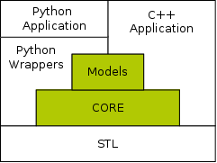
Introduction to ns-3
A discrete event network simulator.
Open source tool with modular design.
Provides a set of simulation models implemented as C++ objects.
More emphasis on emulation.
Ref.: http://www.nsnam.org/

Slide 11
Features of ns-3
Scalability
Packets can have “zero bytes” for dummy application data.
More optional features like no memory wastage in IPv4 Stack for nodes that do not need it.
Logging facility for debugging
Tracing facility for getting output
Cross layer features.
Can be connected to a real network.
Direct Code Execution
Ref.: http://www.nsnam.org/

Slide 12
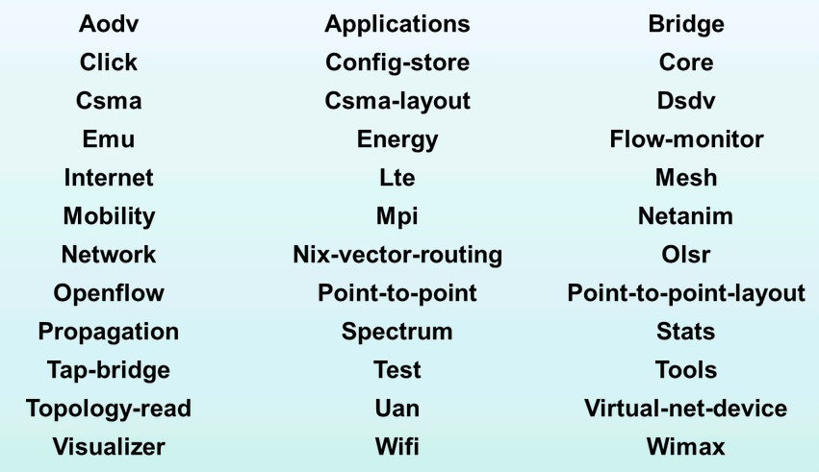
Modules available in ns-3
Ref.: http://www.nsnam.org/

Slide 13
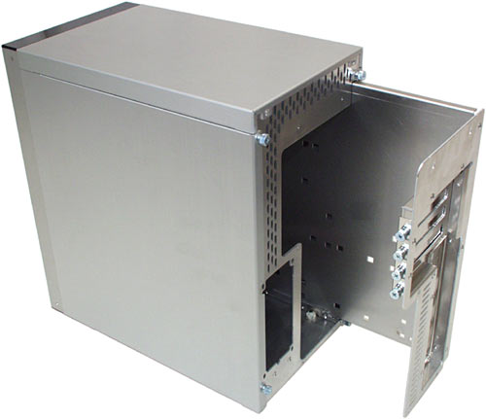


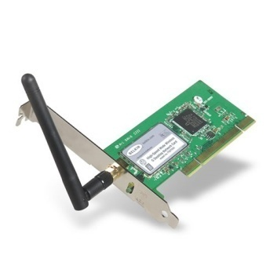
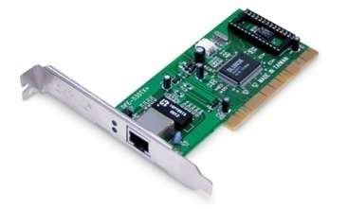
What is a node in ns-3?
Husk of a Computer to which Applications, Stacks and NICs are added.
Application
Application
Application
Ref.: http://www.nsnam.org/

Slide 14
Key Abstractions
Node
Application (e.g., FTP/TCP, ON-OFF Traffic, etc)
Channel (e.g., point-to-point, csma, wi-fi, etc)
NetDevice (i.e., Network Interface Card (NIC), Ethernet, Antenna, etc)
Packet (Message)
Topology Helpers (Agent)
Ref.: http://www.nsnam.org/

Slide 15
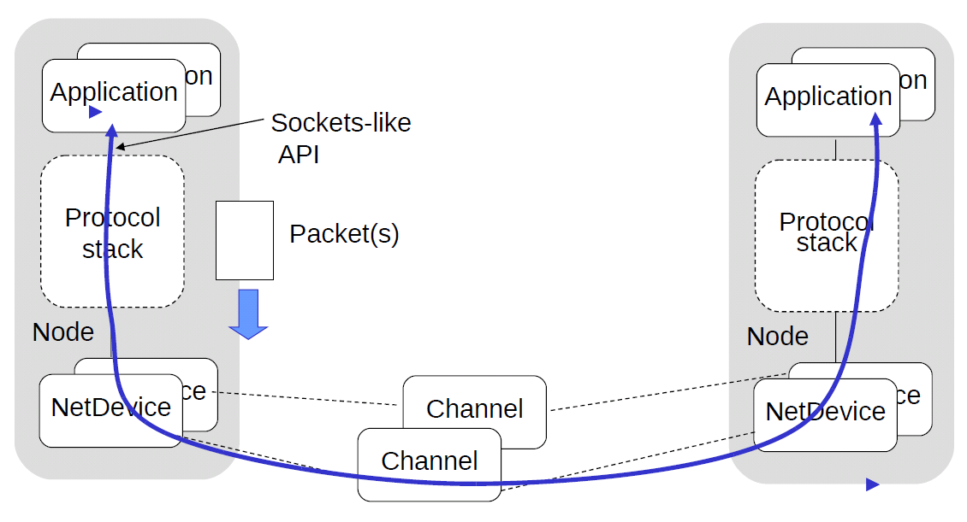
Example - Conceptual
Ref.: http://www.nsnam.org/

Slide 16
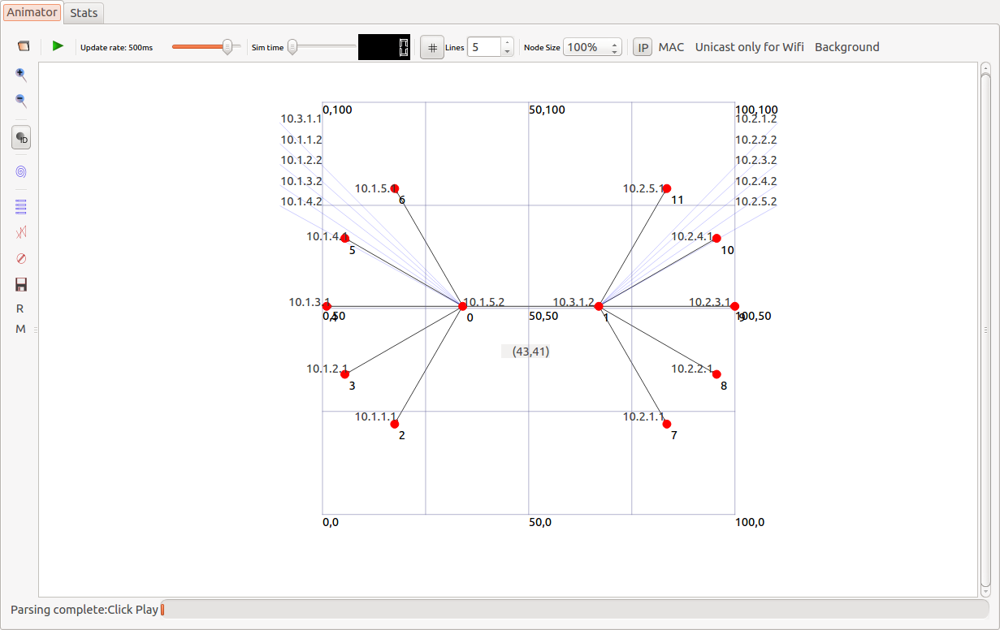
Post processing utilities for ns-3
Snapshot: NetAnim
Ref.: http://www.nsnam.org/

Slide 17
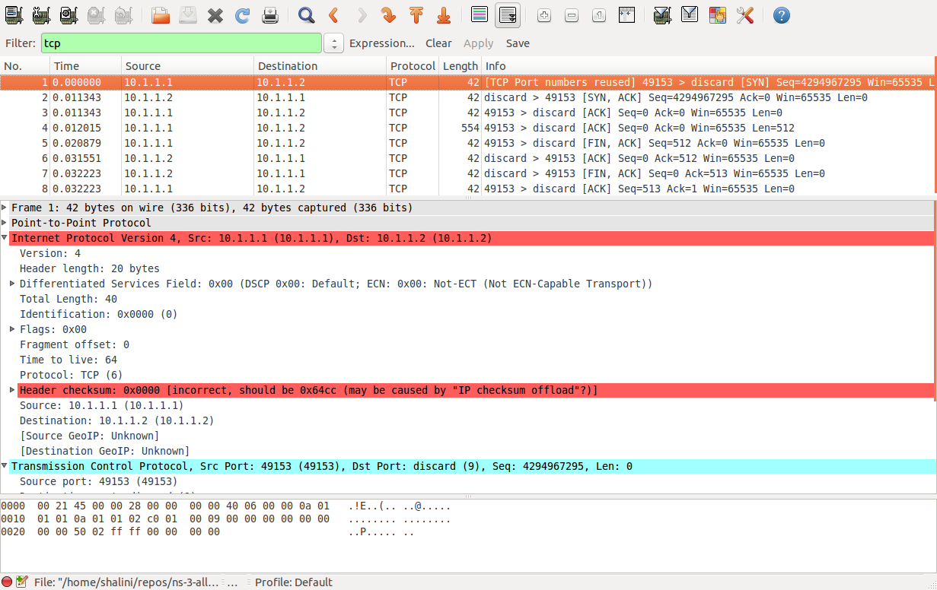
Post processing utilities for ns-3
Snapshot: Wireshark
Ref.: http://www.nsnam.org/

Slide 18
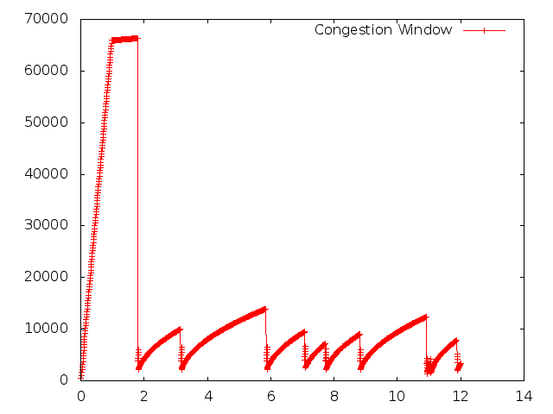
Post processing utilities for ns-3
Snapshot: GNUPlot
Ref.: http://www.nsnam.org/

Slide 19
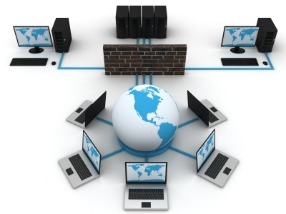
THANK YOU

